Slide 1
SUBMITTED TO : SUBMITTED BY : PRASHANT SAINI YEAR:2019-2020
RAILWAY RESERVATION
SYSTEM

Slide 2

ACKNOWLEDGEMENT
I would like to express my special
thanks of gratitude to my teacher
Mr. VikashKaushik as well as to
our principal Dr. Yachna Bhardwaj
who gave me the golden opportunity
to do this wonderful project on
Railway reservation, which also
helped me in doing a lot of research
and I came to know about so many
things I am really thankful to them.
Secondly I would also like to thanks my
Parents and friends who helped me a lot
in finalizing this project within the limited time frame.

Slide 3
CERTIFICATE
This is to certify that Prashant saini of class XII-B, Rishabh Academy, West End Road, Meerut has successfully completed his project in computer practicals for the AISCCE as prescribed by CBSE in the year 2019-2020.On RALWAY RESERVATION.
Signature of
Computer teacher

Slide 4
CONTENTS
INTRODUCTION
TOPIC
SOURCE CODE
OUTPUT
BIBLIOGRAPHY
QR CODE
DISk

Slide 5
INTRODUCTION
This project introduces Railway reservation system. It explains how reservation is being done in indian railway .This project is developed in c++ language . Almost all the header fies are used in this project. Various functions and structures are used to make a computer use of their language.Those project is well versed with the programing. Railway reservation with the help of this.

Slide 6

RAILWAY RESERVATION
The indian Railways (IR) carries about 5.5 lakh passengers in reserved acccomandation every day. The Comutersied passenger Reservation System(PRS) faciliates the booking and cancellation of tickets from any of the 4000 terminals .These tickets can be booked or cancelled for journeys commencin in any part of india and ending in any other part, with travel time as long as 72 hours and distance upto several thousands kilometers.
The project of PRS was launched on 15th November 1985,over Northern Railway with the installation of Integrated Multiple Train Passenger Reservation System (IMPRESS) ,an online transaction processing system developed by Indian Railways in association with Computer Maintaince Corporation Ltd.., at New Delhi.

Slide 7
SOURCE CODE
//---------------------------------------header file start-----------------------------------------
#include<stdio.h>
#include<stdlib.h>
#include<conio.h>
#include<time.h>
#include<string.h>
//---------------------------------------header file close-------------------------------------------
//---------------------------------------user define function start----------------------------------
void viewinfo();
void bookticket();
void cancelticket();
void admin();
void password();
void viewpassenger();
void addtrain();
void dlttrain();
void awrite();
void aread();
void bookticket_write();
void viewpassengers_read();
//-----------------------------------------user define function close-----------------------------------
//-----------------------------------------structure start----------------------------------------------
struct adddata
{
char si[10];
char train_number[10];
char train_name[20];
char start[10];
char destination[10];
char price[10];
int seat;
char time[10];
} add[200];
struct bookticket
{
char train_number[20];
char name[20];
char phone[20];
char date[20];
int seat;
}book[200];

Slide 8
//---------------------------------------structure close----------------------------------------------
//---------------------------------------global variable----------------------------------------------
int k=0,u=0;
char trn_nmbr[100],name[100],phn[100];
//---------------------------------------main function start------------------------------------------
int main()
{
aread();
viewpassengers_read();
system("COLOR 0f");
int ch;
time_t currentTime;
time(&currentTime);
printf("\n\t\t\t %s\n",ctime(&currentTime));
printf("\n\t\t\t*********************************\n");
printf("\t\t\t*******RAILWAY RESERVATION SYSTEM*******\n");
printf("\t\t\t*********************************\n");
printf("\n\t\t\t<<<<<<<<<<WELCOME USERS>>>>>>>>>>\n");
printf("\n\n\t\t\t\t MENU\n");
printf("\t\t\t ******");
printf("\n\t\t\t[1] VIEW INFORMATION\n");
printf("\n\t\t\t[2] BOOK TICKET\n");
printf("\n\t\t\t[3] CANCEL TICKET\n");
printf("\n\t\t\t[4] ADMIN");
printf("\n\n\t\t\t[5] EXIT\n");
printf("\n\t\t\t********************************");
printf("\n\t\t\t********************************");
printf("\n\t\t\tENTER YOUR CHOICE: ");
scanf("%d",&ch);
switch(ch)
{
case 1:
viewinfo();
break;
case 2:
bookticket();
break;
case 3:
cancelticket();
break;
case 4:
password();
break;
case 5:
system("cls");
printf("\n\t\t\t =========================================\n");

Slide 9
printf("\t\t\t *******RAILWAY RESERVATION SYSTEM MADE BY PRASHANT SAINI*******\n");
printf("\t\t\t ===============================================\n");
getch();
exit(0);
break;
default:
system("cls");
printf("\n\t\t\t==============================================\n");
printf("\t\t\t *******RAILWAY RESERVATION SYSTEM*******\n");
printf("\t\t\t ==============================================\n");
printf("\n\n\t\t\t<<<<<<<<YOU ENTERED WRONG CHOICE>>>>>>>>\n");
printf("\t\t\t<<<<<<<<PLEASE ENTER RIGHT THING>>>>>>>>\n");
getch();
system("cls");
main();
}
return 0;
}
//---------------------------------------main function close--------------------------------------------------
//---------------------------------------book ticket function-----------------------------------------------
void bookticket()
{
int c,j,n,i,found=-1;
char v,train_number[10];
system ("cls");
aread();
printf("\n\n\t\t\t============================================");
printf("\n\t\t\t**********RAILWAY RESERVATION SYSTEM**********\n");
printf("\t\t\t==================================================");
printf("\n\n\t\t\thow many ticket do you want to buy: ");
scanf("%d",&n);
for(j=u;j<u+n;j++)
{
printf("\n\n\t\t\tEnter train number: ");
scanf("%s", book[j].train_number);
for(i=0;i<k;i++)
{
if(strcmp(book[j].train_number,add[i].train_number)==0)
{
if(add[i].seat==0)
{
printf("\n\n\t\t\tnot available seat");

Slide 10
getch();
system("cls");
main();
}
else
{
found=1;
printf("\n\t\t\tenter book %d no ticket: ",j+1);
printf("\n\t\t\tenter date: ");
scanf("%s",book[j].date);
printf("\n\t\t\tenter your name: ");
scanf("%s",book[j].name);
printf("\n\t\t\tenter your phone number: ");
scanf("%s",book[j].phone);
printf("\n\t\t\tseat number : %d",add[i].seat );
book[j].seat=add[i].seat;
bookticket_write();
add[i].seat--;
awrite();
}
}
}
if(found==-1)
{
printf("\n\n\t\t\ttrain not found!!!");
getch();
system("cls");
main();
}
}
u=j;
bookticket_write();
printf("\n\n\t\t\tenter '1' for main menu & press any key to exit: ");
scanf("%d",&c);
if(c==1)
{
system("cls");
main();
}
if(c!=1)
{
exit;
}
}
//---------------------------------------cancel ticket function---------------------------------------------
void cancelticket()
{
viewpassengers_read();
char pnnmbr[100];
int location = -1,e;

Slide 11
int location = -1,e;
printf ("\n\n\t\t\tenter phone number: ");
scanf ("%s",pnnmbr);
for (e=0;e<u;e++)
{
if (strcmp(pnnmbr,book[e].phone)==0)
{
location=e;
break;
}
}
if (location==-1)
{
printf ("\n\n\t\t\t<<<<<<<<<<<<<<Data Not Found>>>>>>>>>>>>>>>>> \n");
getch();
system("cls");
main();
}
else
{
for (e=location;e<u;e++)
{
strcpy(book[e].date,book[e+1].date);
strcpy(book[e].train_number,book[e+1].train_number);
strcpy(book[e].name,book[e+1].name);
strcpy(book[e].phone,book[e+1].phone);
bookticket_write();
}
u--;
bookticket_write();
printf("\n\n\t\t\t<<<<<<<<<<<<<<<ticket cancelled successfully>>>>>>>>>>>>");
getch();
system("cls");
main();
}
}
//-------------------------------------admin portal function----------------------------------------
void admin()
{
int chhh;
system("cls");
printf("\n ==================================================================");
printf("\n ********************RAILWAY RESERVATION SYSTEM*******************");
printf("\n ====================================================================");
printf("\n\n");
printf(" <<<<<<<<<<<<<<<WELCOME_ADMIN>>>>>>>>>>>>>>>\n");
printf("\n\n");
printf(" ************************************\n");
printf(" || CHOOSE YOUR OPERATION ||\n");
printf(" ||--------------------------------||\n");

Slide 12
printf(" || [1] VIEW PASSENGERS ||\n");
printf(" || [2] ADD TRAIN ||\n");
printf(" || [3] DELETE TRAIN ||\n");
printf(" || [4] BACK ||\n");
printf(" || ||\n");
printf(" ************************************\n\n");
printf(" **********************************************************\n");
printf("\n\t\tENTER YOUR CHOICE: ");
scanf("%d",&chhh);
switch(chhh)
{
case 1:
viewpassenger();
break;
case 2:
addtrain();
break;
case 3:
dlttrain();
break;
case 4:
system("cls");
getch();
main();
break;
default:
getch();
printf("\n\t\t\tyou entered wrong KEY!!!!");
getch();
system("cls");
main();
}
getch();
}
//-----------------------------password function----------------------------------
void password()
{
int number=1234567;
int pass;
printf("\n\t\t\tenter password: ");
scanf("%d",&pass);
if(pass==number)
{
printf("\n\n\t\t\t<<<<<login successfully>>>>>");
getch();
system("cls");
admin();
}

Slide 13
else
{
printf("\n\n\t\t\t\t ERROR!!!!!");
printf("\n\n\t\t\t<<<<<<<<wrong password>>>>>>>>");
getch();
system("cls");
main();
}
}
//------------------------------------delete train function----------------------------------------------
void dlttrain()
{
aread();
char train[100];
int location = -1,f;
printf ("\n\n\tenter train number: ");
scanf ("%s",train);
for (f=0;f<k;f++)
{
if (strcmp(train,add[f].train_number)==0)
{
location=f;
break;
}
}
if (location==-1)
{
printf ("\n\n\t<<<<<<<<<<<<<<Data Not Found>>>>>>>>>>>>>>>>> \n");
getch();
system("cls");
admin();
}
else
{
for (f=location;f<k;f++)
{
strcpy(add[f].si,add[f+1].si);
strcpy(add[f].train_number,add[f+1].train_number);
strcpy(add[f].train_name,add[f+1].train_name);
strcpy(add[f].start,add[f+1].start);
strcpy(add[f].destination,add[f+1].destination);
strcpy(add[f].price,add[f+1].price);
strcpy(add[f].time,add[f+1].time);
awrite();
}
k--;
awrite();
printf("\n\n\t<<<<<<<<<<<<<train deleted successfully>>>>>>>>>>>>>");
getch();
system("cls");

Slide 14
system("cls");
admin();
}
}
//--------------------------------------view passengers function----------------------------------------
void viewpassenger()
{
int a,j;
system("cls");
viewpassengers_read();
printf("\n\t\t\t **********************************************************");
printf("\n\t\t\t ********************RAILWAY RESERVATION SYSTEM********************");
printf("\n\t\t\t **********************************************************");
printf("\n\n\t\t\ttrain number\t\tname\t\tphone number\t\tdate\t\tseat\n");
printf("\n\t\t\t**********************************************************************************\n");
for(j=0;j<u;j++)
{
printf("\n\t\t\t%s\t\t\t%s\t\t%s\t\t%s\t%d",book[j].train_number,book[j].name,book[j].phone,book[j].date,book[j].seat);
book[j].seat++;
}
printf("\n\t\t\t**********************************************************************************\n");
printf("\n\n\t\t\tenter '1' for main menu & enter '0' for back: ");
scanf("%d",&a);
if(a==1)
{
system("cls");
main();
}
if(a==0)
{
system("cls");
admin();
}
}
//--------------------------------------add train function--------------------------------------------
void addtrain()
{
system("cls");

Slide 15
printf("\n\t\t **********************************************************");
printf("\n\t\t ********************RAILWAY RESERVATION SYSTEM********************");
printf("\n\t\t **********************************************************");
printf("\n\n\t\t\thow many trains do you want to add: ");
scanf("%d",&a);
for(i=k;i<k+a;i++)
{
printf("\n\t\t\tenter %d train details: ",i+1);
printf("\n\t\t\tenter serial number: ");
scanf("%s",add[i].si);
printf("\n\t\t\tenter train number: ");
scanf("%s",add[i].train_number);
printf("\n\t\t\tenter train name: ");
scanf("%s",add[i].train_name);
printf("\n\t\t\tenter start place: ");
scanf("%s",add[i].start);
printf("\n\t\t\tenter destination place: ");
scanf("%s",add[i].destination);
printf("\n\t\t\t enter price: ");
scanf("%s",add[i].price);
printf("\n\t\t\t enter seat: ");
scanf("%d", & add[i].seat);
printf("\n\t\t\t enter time: ");
scanf("%s",add[i].time);
}
printf("\n\n\t\t\tconfirm train: (y=1/n=0):- ");
scanf("%d",&ch);
if(ch==1)
{
awrite();
k=i;
awrite();
system("cls");
printf("\n\n\t\t\t**********************************************************");
printf("\n\t\t\t********************RAILWAY RESERVATION SYSTEM********************");
printf("\n\t\t\t**********************************************************");
printf("\n\n");
printf("\n\t\t\t\t **********************************");
printf("\n\t\t\t\t *<<<<<train add successfully>>>>>*");
printf("\n\t\t\t\t **********************************");

Slide 16
getch();
system("cls");
main();
}
if(ch==0)
{
system("cls");
admin();
}
if((ch!=1)&&(ch!=0))
{
system("cls");
main();
}
}
//-----------------------------------view information function--------------------------------------
void viewinfo()
{
int ch,i;
system("cls");
aread();
printf("\n\t\t **********************************************************");
printf("\n\t\t ********************RAILWAY RESERVATION SYSTEM********************");
printf("\n\t\t **********************************************************");
printf("\n\n\n SI\ttrain number\ttrain name\tstart place\tdestination place\tprice\tseat\ttime\n\n");
for(i=0;i<k;i++)
{
printf(" %s\t%s\t\t%s\t\t%s\t\t%s\t\t\t%s\t%d\t%s\n",add[i].si,add[i].train_number,add[i].train_name,add[i].start,add[i].destination,add[i].price,add[i].seat,add[i].time);
}
printf(" ***********************************************************************************************\n");
printf("\n\t\t\tpress '1' for main menu & press any key for exit: ");
scanf("%d",&ch);
switch(ch)
{
case 1:
system("cls");
main();
break;
d

Slide 17
default:
exit(0);
}
}
//------------------------------------------book ticket file start-----------------------------------------
void bookticket_write()
{
FILE *booklist;
booklist=fopen("booklist.txt","w");
fwrite(&book,sizeof(book),1,booklist);
fclose(booklist);
FILE *booklistreport;
booklistreport=fopen("booklistreport.txt","w");
fwrite(&u,sizeof(u),1,booklistreport);
fclose(booklistreport);
}
void viewpassengers_read()
{
FILE *booklist;
booklist=fopen("booklist.txt","r");
fread(&book,sizeof(book),1,booklist);
fclose(booklist);
FILE *booklistreport;
booklistreport=fopen("booklistreport.txt","r");
fread(&u,sizeof(u),1,booklistreport);
fclose(booklistreport);
}
//-----------------------------------------add train file start---------------------------------------------------
void awrite()
{
FILE *train_details;
train_details = fopen("train_details.txt","w");
fwrite(&add,sizeof(add),1,train_details);
fclose(train_details);
FILE *train_report;
train_report = fopen("train_report.txt","w");
fwrite(&k,sizeof(k),1,train_report);
fclose(train_report);
}

Slide 18
void aread()
{
FILE *train_details;
train_details = fopen("train_details.txt","r");
fread(&add,sizeof(add),1,train_details);
fclose(train_details);
FILE *train_report;
train_report = fopen("train_report.txt","r");
fread(&k,sizeof(k),1,train_report);
fclose(train_report);
}
//----------------------------------------------------file close----------------------------------------------
//----------------------------------------------------program close----------------------------------------

Slide 19
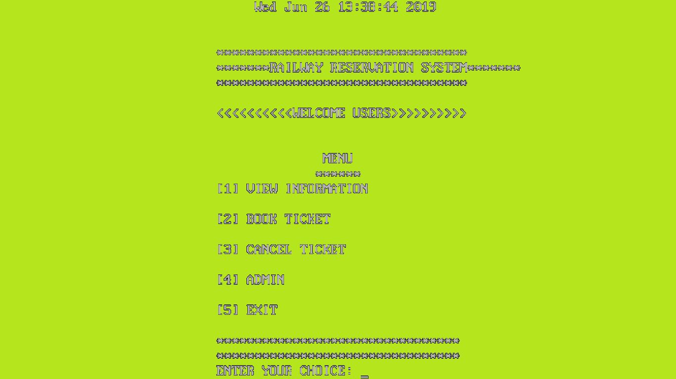
OUTPUT 1 (Main menu)

Slide 20
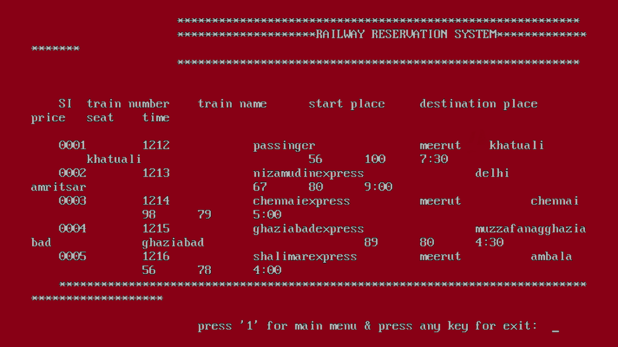
OUTPUT 2 (View trains)

Slide 21
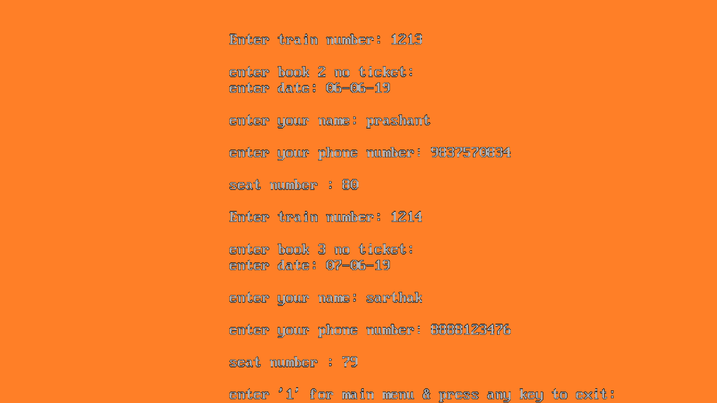
OUTPUT 3 (Book tickets)

Slide 22
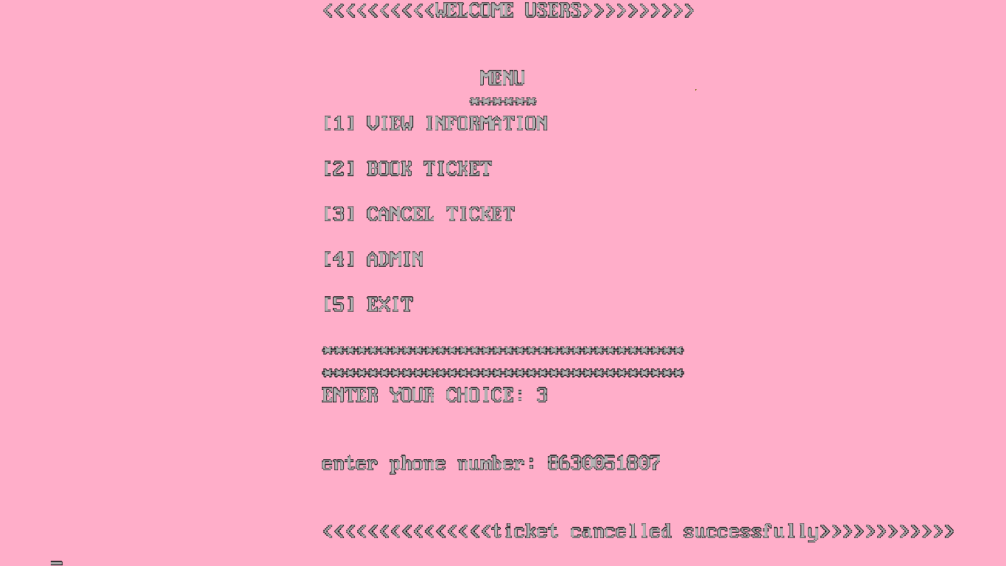
OUTPUT 4 (Cancel tickets)

Slide 23
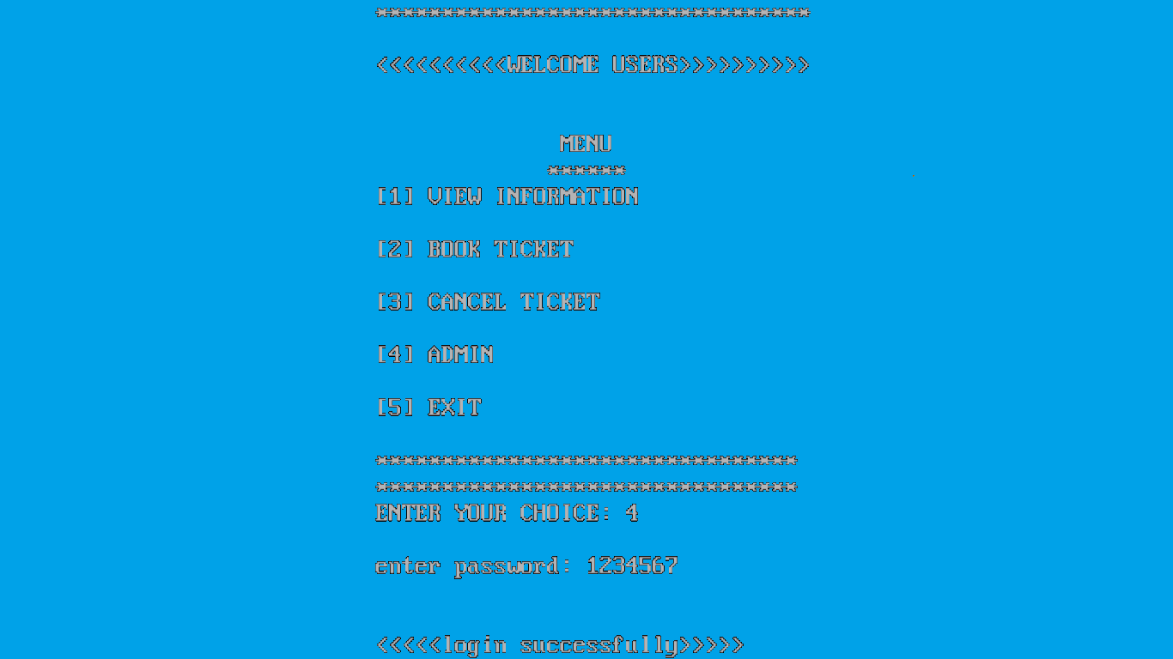
OUTPUT 5 (Admin login)

Slide 24
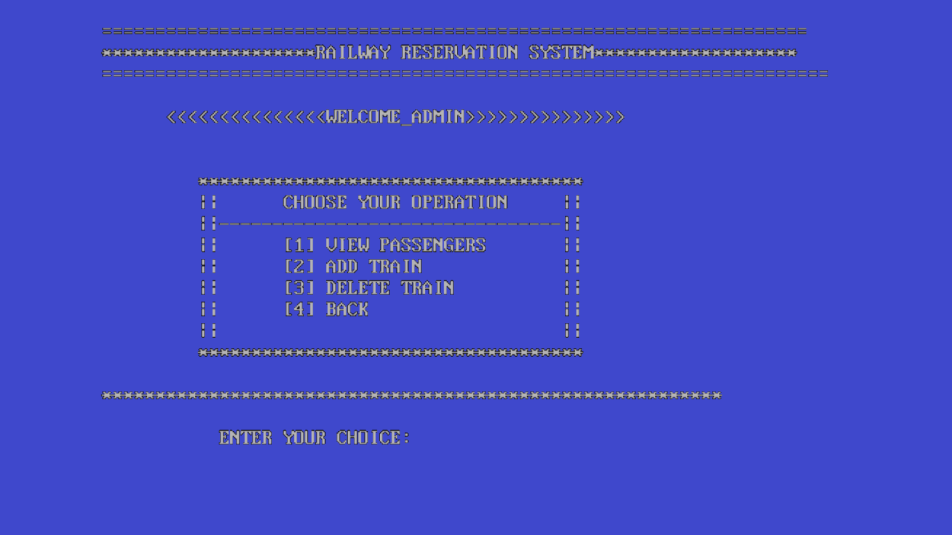
OUTPUT 6 (Admin menu)

Slide 25
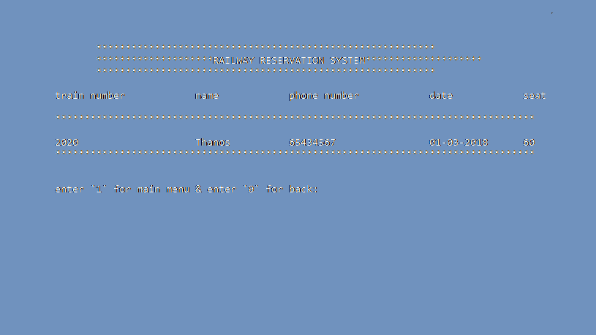
OUTPUT 7 (View passengers)

Slide 26
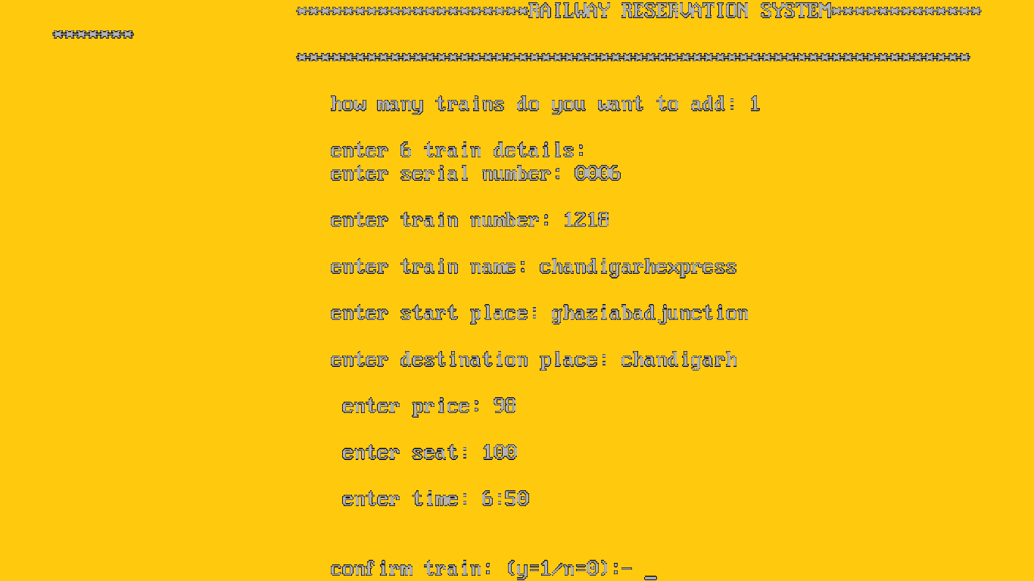
OUTPUT 8 (Trains added)

Slide 27
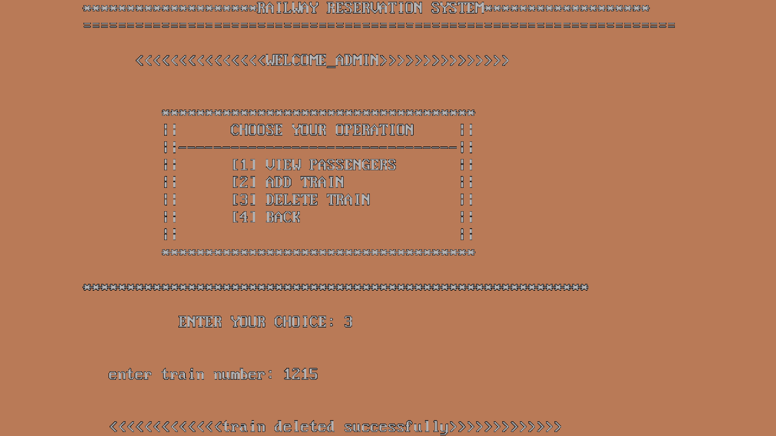
OUTPUT 9 (Cancel trains)

Slide 28
*HELP FROM INTERNET *HELP FROM TEACHER *WITH THE HELP OF BOOK *INFORMATION FROM LIBRARY
BIBLIOGRAPHY

Slide 29
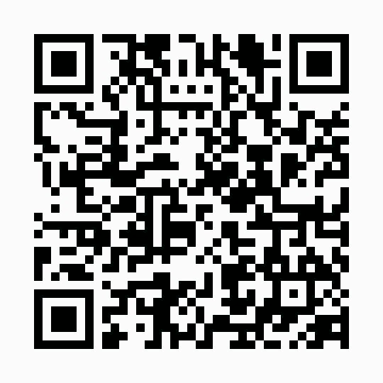

QR CODE

Slide 30
CD

Slide 31
THANK YOU!
PRASHANTSAINI
Email: sainiprashant300@gmail.com
**THE END**

